Slide 1

University Institute of Engineering
DEPARTMENT OF COMPUTER SCIENCE & ENGINEERING
Bachelor of Engineering (Computer Science & Engineering)
Subject Name : Machine Learning
Subject Code:CST-316
Topic: Machine learning Introduction
Lecture: Zero(1st Day)
By : Baljeet Kaur Nagra
DISCOVER . LEARN . EMPOWER

Slide 2
Vision Of University
“To be globally recognized as a Centre of Excellence for Research, Innovation, Entrepreneurship and disseminating knowledge by providing inspirational learning to produce professional leaders for serving the society”.

Slide 3
Mission Of University
Providing world class infrastructure, renowned academicians and ideal environment for Research, Innovation, Consultancy and Entrepreneurship relevant to the society.
Offering programs & courses in consonance with National policies for nation building and meeting global challenges.
Designing Curriculum to match International standards, needs of Industry, civil society and for inculcation of traits of Creative Thinking and Critical Analysis as well as Human and Ethical values.
Ensuring students delight by meeting their aspirations through blended learning, corporate mentoring, professional grooming, flexible curriculum and healthy atmosphere based on co-curricular and extra-curricular activities.
Creating a scientific, transparent and objective examination/evaluation system to ensure an ideal certification.
Establishing strategic relationships with leading National and International corporate and universities for academic as well as research collaborations.
Contributing for creation of healthy, vibrant and sustainable society by involving in Institutional Social Responsibility (ISR) activities like rural development, welfare of senior citizens, women empowerment, community service, health and hygiene awareness and environmental protection

Slide 4
Vision Of Department
“To be recognized as a leading Computer Science and Engineering department through effective teaching practices and excellence in research and innovation for creating competent professionals with ethics, values and entrepreneurial attitude to deliver service to society and to meet the current industry standards at the global level”.

Slide 5
Mission Of Department
M1: To provide practical knowledge using state-of-the-art technological support for the experiential learning of our students.
M2: To provide industry recommended curriculum and transparent assessment for quality learning experiences.
M3: To create global linkages for interdisciplinary collaborative learning and research.
M4: To nurture advanced learning platform for research and innovation for students’ profound future growth.
M5: To inculcate leadership qualities and strong ethical values through value based education.

Slide 6
PEO’s(Program Educational Objectives )
The statements of PEOs (revised from 2022) are given below:
PEO 1. Graduates of the Computer Science and Engineering can contribute to the Nation’s growth through their ability to solve diverse and complex computer science & engineering problems across a broad range of application areas.
PEO 2. Graduates of the Computer Science and Engineering can be successful professionals, designing and implementing Products & Services of global standards in the field of Computer Science & Engineering, becoming entrepreneurs, pursuing higher studies & research.
PEO 3. Graduates of the Computer Science and Engineering Program can be able to adapt to changing scenario of dynamic technology with an ability to solve larger societal problems using logical and flexible approach in decision making.

Slide 7
Program Outcomes (POs)
PO1: Engineering knowledge: Apply the knowledge of Mathematics, Science, Engineering fundamentals and computer science fundamental and strategies which have the solution of complex computer science engineering problems.
PO2: Problem analysis: Identify, formulate, research literature, and analyze complex computer science engineering problems reaching substantiated conclusions using first principles of mathematics, natural sciences, and engineering sciences.
PO3: Design/development of solutions: Design solutions for complex database and software engineering problems and design system components or processes that meet the specified needs with appropriate considerations for the public health and safety, and the cultural, societal, and environmental considerations.

Slide 8
Program Outcomes (POs)
PO4: Conduct investigations of complex problems: Use research-based knowledge and research methods including design of software engineering & networking based experiments, analysis and Interpretation of data, and synthesis of the information to provide valid conclusions.
PO5: Modern tool usage: Create, select, and apply appropriate techniques, resources, and modern Computer science engineering and IT tools including prediction and modeling to complex database or software engineering activities with an understanding of the limitations.
PO6: The engineer and society: Apply reasoning informed by the contextual knowledge to assess social, health, safety, legal and cultural issues and the consequent responsibilities relevant to the Professional Computer Science & Engineering practice.

Slide 9
Program Outcomes (POs)
PO7: Environment and sustainability: Understand the impact of the professional computer science and engineering solutions in social and environmental contexts, and demonstrate the knowledge of, and need for sustainable development goals.
PO8: Ethics: Apply ethical principles and commit to professional ethics and responsibilities and norms of computer science engineering practice
PO9: Individual and team work: Function effectively as an individual, and as a member or leader in diverse teams, and in multidisciplinary settings.

Slide 10
Program Outcomes (POs)
PO10: Communication: Communicate effectively on complex computer science engineering activities with the engineering community like CSI society at large, such as, being able to comprehend and write effective reports and design documentation, make effective presentations, and give and receive clear instructions.
PO11: Project management and finance: Demonstrate knowledge and understanding of the computer science engineering and management principles and apply these to one’s own work, as a member and leader in a team, to manage projects and in multidisciplinary environments.
PO12: Life-long learning: Recognize the need for, and have the preparation and ability to engage in independent and life- long learning in the broadest context of computer science engineering changes

Slide 11
Program Specific Outcomes (PSOs)
A Graduate of Computer Science and Engineering Program will be able:
PSO1. To acquire proficiency in developing and implementing efficient solutions using emerging technologies, platforms and Free and Open-Source Software (FOSS).
PSO2. To gain critical understanding of hardware and software tools catering to the contemporary needs of IT industry.

Slide 12
Course Outcomes
CO-1:Apply the basic concept of Machine learning and statistics learning to deal with real-life Problems.
CO-2: Understand different machine learning algorithms, as well as underlying theories the behind them.
CO-3: Select and apply the appropriate machine learning algorithm to solve problems of moderate complexity
CO-4: Interpret and evaluate models generated from data.
CO-5: Optimize the models learned and report on the expected accuracy that can be attained by applying the algorithms to a real-world problem.

Slide 13
Course Objectives
To understand the history and development of Machine Learning.
To provide a comprehensive foundation to Machine Learning and Optimization methodology with applications .
To study learning processes: supervised and unsupervised, deterministic and statistical knowledge of Machine learners, and ensemble learning
To understand modern techniques and practical trends of Machine learning.

Slide 14
Syllabus( Theory)
Unit 1 (14 hrs)
Fundamentals of Machine Learning: Introduction to Machine Learning (ML), Different types of Machine Learning, Machine Learning Life Cycle: Data Discovery, Exploratory Analysis: Data Preparation, Model Planning, Model Building, Model Evaluation, Real World Case Study. Foundation of ML: ML Techniques.
Statistics Learning and Exploratory Data Analysis : Mean Median, Mode, Correlation, Covariance, Quartile, Maximum Likelihood, Bayesian Inference, Bias, Variance, Distance metrics: Euclidean Distance, Manhattan Distance, Gaussian (or Normal) Distributions, statistical hypothesis testing. Missing Value treatment, Outlier Detection, Feature Engineering, Graphs and Plots.
Supervised Learning with Regression and Classification techniques -1: Linear Regression, Multiple Regression, Bias-Variance Dichotomy, Model Validation Approaches, Evaluation of the performance of an algorithm: Mean Squared Error, Root Mean Squared Error.

Slide 15
Unit 2 (15 hrs)
Supervised Learning with Regression and Classification techniques -2:
Logistic Regression, Support Vector Machine (SVM), Naive Bayesian Classifier, K-Nearest Neighbor (KNN), Cross-Validation, Confusion Matrix. Evaluation of the performance of an algorithm: Accuracy, Error Rate, Precision, Recall, Specificity, F1 Score. Decision Tree: Picking the best splitting attribute, entropy and information gain, over fitting and under fitting, noisy data and pruning. Ensemble Methods: Random Forest,
Unit 3 (16 hrs)
Unsupervised Learning: Clustering, Partitioning Method - K-means, K-medioids, Hierarchical Clustering- Agglomerative and divisive clustering, Evaluation of clustering algorithms. Principal Component Analysis (Eigen values, Eigen Vectors, Orthogonality). Association Rules: Association Rule mining, Apriori Algorithm, Support and Confidence Parameters, Lift and Leverage. Feature Reduction and Dimensionality Reduction.
Semi-Supervised Learning: Introduction, Assumptions, Working and Real-World Applications. Reinforcement Learning: Introduction, Applications and Examples, Challenges of applying reinforcement learning, reinforcement learning algorithm.

Slide 16
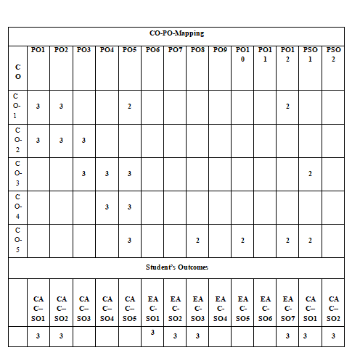
CO_PO_SO Mapping

Slide 17
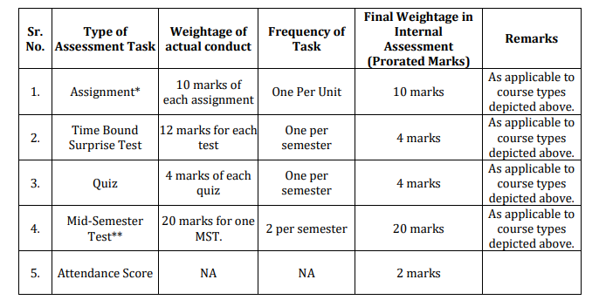
Assessment Model Theory

Slide 18
Syllabus Practical(List Of Experiments )
UNIT-I
Implement Exploratory Data Analysis on any data set.
Implement Data Visualization.
Implement Linear Regression on any data set.
UNIT-II
Implement Support Vector Machine on any data set and analyze the accuracy with Logistic regression
Implement Naïve Bayes on any dataset.
Implement K-Nearest Neighbor on any data set
Implement Decision Tree and compare the performance with Random Forest on any data set.
UNIT-III
Implement K-means clustering algorithm (cluster some sample data set into disjoint clusters using K-means).
Implement Principle Component Analysis.
Implement Association Rule Mining.

Slide 19
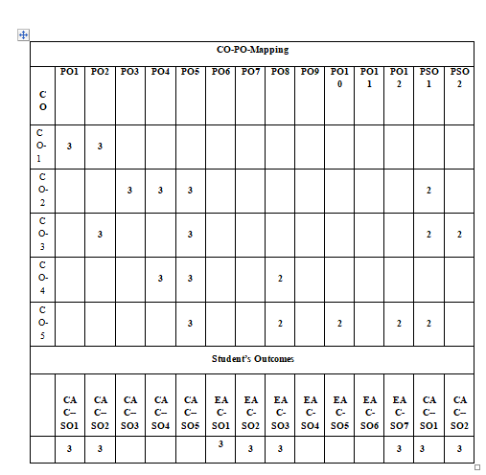
CO_PO_SO Mapping

Slide 20
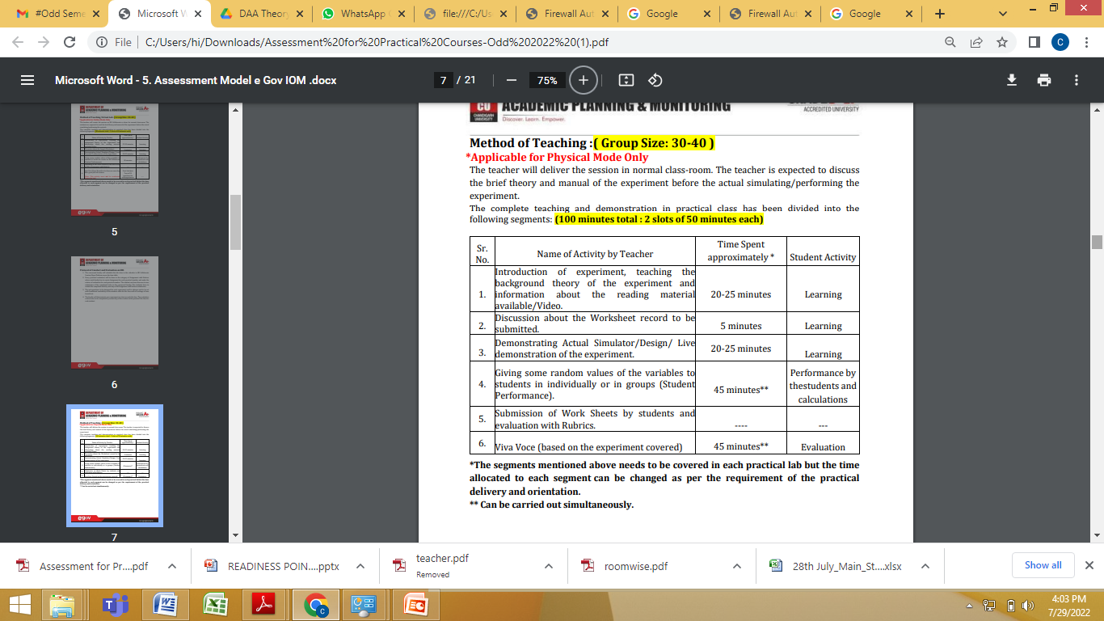
Method of Teaching Practical

Slide 21
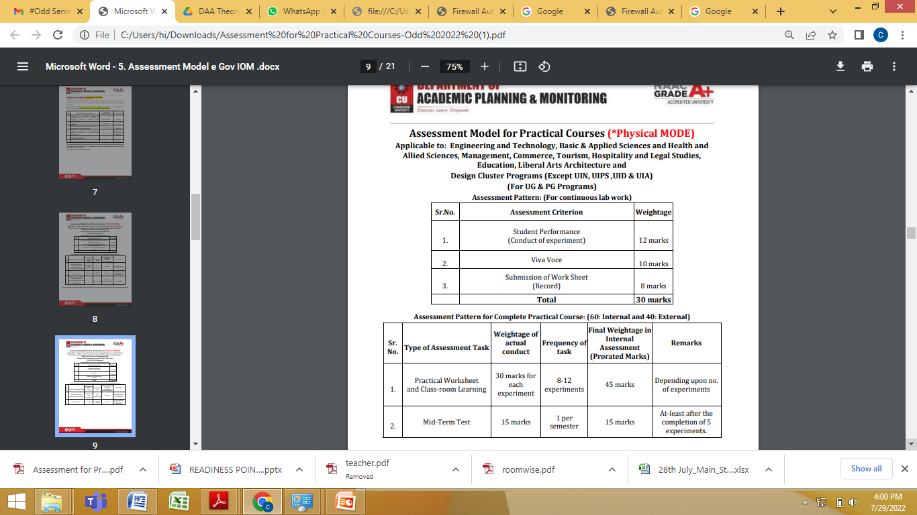
Assessment Model for Lab

Slide 22
Student Attendance/Leave Policy
https://drive.google.com/file/d/1CHp7Sn0zaw-5TRydAj6Dz5uoh5EOejsY/view?usp=sharing
https://docs.google.com/document/d/1NOZMDxXfjYGDetoVvO_cQlc9vlQkgb2pWFrfbSd1_0Q/edit?usp=sharing

Slide 23
Contents
Machine Learning Introduction
History
Need/Importance
Advantages
Limitations
Applications

Slide 24
Machine Learning Introduction
Machine learning is the science of getting computers to realize a task without being explicitly programmed.
In other words, the big difference between classical and machine learning algorithms lies in the way we define them.
Classical algorithms are given exact and complete rules to complete a task.
Machine learning algorithms are given general guidelines that define the model, along with data.
This data should contain the missing information necessary for the model to complete the task.
So, a machine learning algorithm can accomplish its task when the model has been adjusted with respect to the data.
We say that we “fit the model on the data” or that “the model has to be trained on the data.”

Slide 25
History
Computers are used in almost all disciplines that include science, technology and medical science etc.
Computing techniques are used to find exact solutions of scientific problems. The solutions are attempted on the basis of two valued logic and classical mathematics.
However, all real life problems cannot be handled by conventional methods.
Zadeh, who is known as the father of Fuzzy Logic has mentioned that humans are able to resolve tasks of high complexity without measurement or computation.
Hence the need arose for developing systems that work on Artificial Intelligence .
Artificial Intelligence (AI) is the field that studies how machine can be made to act intelligently.The term "Artificial Intelligence" was coined by John McCarthy in 1956.
Machine learning grew out of the quest for artificial intelligence when some researchers were interested in having machines learn from data.The term machine learning was coined in 1959 by Arthur Samuel.

Slide 26
History
AI became a field of research to build models and systems that act intelligently without human intervention.
In mid 1980s Zadeh focused on building systems or making computers think like humans.
For this purpose, the Machines’ ability to compute with numbers which is named as hard computing has to be supplemented by an additional ability more similar to human thinking which is named as soft computing.
Soft computing is a term coined by Zadeh, combing a collection of computing techniques, spanning many fields that fall under various categories in computational intelligence.
Soft computing has three main branches, Fuzzy system, Evolutionary computation, Artificial Neural computing which sub-sums Machine Learning.
The guiding principle of soft computing is “Exploit the tolerance for imprecision, uncertainty and partial truth to achieve tractability, robustness and low solution cost”.

Slide 27
Need/Importance
Machine learning techniques are used to automatically find the valuable underlying patterns within complex data that we would otherwise struggle to discover.
The hidden patterns and knowledge about a problem can be used to predict future events and perform all kinds of complex decision making.
Traditionally, software engineering combined human created rules with data to create answers to a problem.
Instead, machine learning uses data and answers to discover the rules behind a problem.
To learn the rules governing a phenomenon, machines have to go through a learning process, trying different rules and learning from how well they perform.
Hence, why it’s known as Machine Learning.

Slide 28
Advantages
1. Easily identifies trends and patterns
Machine Learning can review large volumes of data and discover specific trends and patterns that would not be apparent to humans.
2. No human intervention needed (automation)
With ML, you don’t need to babysit your project every step of the way. Since it means giving machines the ability to learn, it lets them make predictions and also improve the algorithms on their own.
3. Continuous Improvement
As ML algorithms gain experience, they keep improving in accuracy and efficiency. This lets them make better decisions.
4. Handling multi-dimensional and multi-variety data
Machine Learning algorithms are good at handling data that are multi-dimensional and multi-variety, and they can do this in dynamic or uncertain environments.
5. Wide Applications
It holds the capability to help deliver a much more personal experience to customers while also targeting the right customers.

Slide 29
Limitations
1. Data Acquisition
Machine Learning requires massive data sets to train on, and these should be inclusive/unbiased, and of good quality. There can also be times where they must wait for new data to be generated.
2. Time and Resources
ML needs enough time to let the algorithms learn and develop enough to fulfill their purpose with a considerable amount of accuracy and relevancy. It also needs massive resources to function. This can mean additional requirements of computer power for you.
3. Interpretation of Results
Another major challenge is the ability to accurately interpret results generated by the algorithms. You must also carefully choose the algorithms for your purpose.
4. High error-susceptibility
Suppose you train an algorithm with data sets small enough to not be inclusive. You end up with biased predictions coming from a biased training set. This leads to irrelevant advertisements being displayed to customers.
In the case of ML, such blunders can set off a chain of errors that can go undetected for long periods of time. And when they do get noticed, it takes quite some time to recognize the source of the issue, and even longer to correct it.

Slide 30
Applications
1. Virtual Personal Assistants: Amazon Echo and Google Home, Siri, Alexa
2. Predictions while Commuting: Traffic Predictions, Weather Predictions
3. Videos Surveillance
4. Social Media Services: People You May Know, Face Recognition, Similar Pins
5. Email Spam and Malware Filtering
6. Online Customer Support
7. Search Engine Result Refining
8. Product Recommendations
9. Online Fraud Detection

Slide 31
Case Study
Practical Bayesian Optimization of Machine Learning Algorithms
https://docs.google.com/document/d/1Lt0C1XzOpUtWAUjI7YLVPYG3tfPg7jKMCIhulTfJ2E0/edit?usp=sharing

Slide 32
References
Books and Journals:
Understanding Machine Learning: From Theory to Algorithms by Shai Shalev-Shwartz and Shai Ben-David-Cambridge University Press 2014
Introduction to machine Learning – the Wikipedia Guide by Osman Omer.
Kevin P. Murphy, Machine Learning: A Probabilistic Perspective (Adaptive Computation and Machine Learning series) Illustrated Edition, MIT Press, 2012.
Mehryar Mohri. T, Foundations of Machine Learning (Adaptive Computation and Machine Learning series), MIT Press,2012.
Andreas C. Mueller "Introduction to Machine Learning with Python: A Guide for Data Scientists.", O′Reilly, 2016
The Elements of Statistical Learning, by Trevor Hastie, Robert Tibshirani, Jerome H. Friedman

Slide 33
E-Learning
Video Link-
https://www.youtube.com/watch?v=9f-GarcDY58
https://www.youtube.com/watch?v=GwIo3gDZCVQ
Web Link-
https://data-flair.training/blogs/advantages-and-disadvantages-of-machine-learning/
https://towardsdatascience.com/machine-learning-an-introduction-23b84d51e6d0
https://towardsdatascience.com/introduction-to-machine-learning-f41aabc55264

Slide 34
Target Companies
CommScope India Private Limited (Commscope.com)
Nutanix India Technologies Pvt. Ltd
Apisero India Pvt. Ltd
EPIKInDiFi Software & Solutions Private Limited
WorkIndia (Eloquent Info Solutions Pvt. Ltd.)
ShareChat (Mohalla Tech Private Limited)
Salesforce India Pvt Ltd
BrowserStack Software Pvt. Ltd
Zscaler Softech India Private Limited
Daffodil Software
Saviynt India Private Limited
GlobalLogic-Hitachi

Slide 35
Target Companies
Clarivate Analytics
Avalara Technologies Private Limited
F5 Networks Innovation Private Limited
Innovaccer Analytics Pvt Ltd
GRAB GRECO LLP
Virtusa -Codelite
Clumio Technologies
Zscaler Softech India Private Limited

Slide 36
THANK YOU

